Slide 1
Assembly Language for Intel-Based Computers, 4th Edition
Kip R. Irvine
Chapter 8:Advanced Procedures
Slides prepared by Kip R. Irvine
Revision date: 07/11/2002
Chapter corrections (Web) Assembly language sources (Web)
(c) Pearson Education, 2002. All rights reserved. You may modify and copy this slide show for your personal use, or for use in the classroom, as long as this copyright statement, the author's name, and the title are not changed.

Slide 2
Chapter Overview
Local Variables
Stack Parameters
Stack Frames
Recursion
Creating Multimodule Programs

Slide 3
Local Directive
A local variable is created, used, and destroyed within a single procedure
The LOCAL directive declares a list of local variables
  immediately follows the PROC directive
  each variable is assigned a type
Syntax:
    LOCAL varlist
Example:
MySub PROC
LOCAL var1:BYTE, var2:WORD, var3:SDWORD

Slide 4
Local Variables
Examples:
LOCAL flagVals[20]:BYTE ; array of bytes
LOCAL pArray:PTR WORD ; pointer to an array
myProc PROC, ; procedure
p1:PTR WORD ; parameter
LOCAL t1:BYTE, ; local variables
t2:WORD,
t3:DWORD,
t4:PTR DWORD

Slide 5
MASM-Generated Code (1 of 2)
BubbleSort PROC
LOCAL temp:DWORD, SwapFlag:BYTE
. . .
ret
BubbleSort ENDP
MASM generates the following code:
BubbleSort PROC
push ebp
mov ebp,esp
add esp,0FFFFFFF8h ; add -8 to ESP
. . .
mov esp,ebp
pop ebp
ret
BubbleSort ENDP

Slide 6
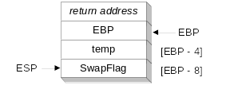
MASM-Generated Code (2 of 2)
Diagram of the stack frame for the BubbleSort procedure:

Slide 7
Stack Parameters
Register vs. Stack Parameters
INVOKE Directive
PROC Directive
PROTO Directive
Passing by Value or by Reference
Parameter Classifications
Example: Exchanging Two Integers
Trouble-Shooting Tips

Slide 8
Register vs. Stack Parameters
Register parameters require dedicating a register to each parameter. Stack parameters are more convenient
Imagine two possible ways of calling the DumpMem procedure. Clearly the second is easier:
pushad
mov esi,OFFSET array
mov ecx,LENGTHOF array
mov ebx,TYPE array
call DumpMem
popad
push OFFSET array
push LENGTHOF array
push TYPE array
call DumpMem

Slide 9
INVOKE Directive
The INVOKE directive is a powerful replacement for Intel’s CALL instruction that lets you pass multiple arguments
Syntax:
    INVOKE procedureName [, argumentList]
ArgumentList is an optional comma-delimited list of procedure arguments
Arguments can be:
  immediate values and integer expressions
  variable names
  address and ADDR expressions
  register names

Slide 10
INVOKE Examples
.data
byteVal BYTE 10
wordVal WORD 1000h
.code
; direct operands:
INVOKE Sub1,byteVal,wordVal
; address of variable:
INVOKE Sub2,ADDR byteVal
; register name, integer expression:
INVOKE Sub3,eax,(10 * 20)
; address expression (indirect operand):
INVOKE Sub4,[ebx]

Slide 11
ADDR Operator
Returns a near or far pointer to a variable, depending on which memory model your program uses:
  Small model: returns 16-bit offset
  Large model: returns 32-bit segment/offset
  Flat model: returns 32-bit offset
Simple example:
.data
myWord WORD ?
.code
INVOKE mySub,ADDR myWord

Slide 12
PROC Directive
The PROC directive declares a procedure with an optional list of named parameters.
Syntax:
  label PROC paramList
paramList is a list of parameters separated by commas. Each parameter has the following syntax:
  paramName:type
type must either be one of the standard ASM types (BYTE, SBYTE, WORD, etc.), or it can be a pointer to one of these types.

Slide 13
PROC Examples (1 of 3)
The AddTwo procedure receives two integers and returns their sum in EAX.
C++ programs typically return 32-bit integers from functions in EAX.
AddTwo PROC,
val1:DWORD, val2:DWORD
mov eax,val1
add eax,val2
ret
AddTwo ENDP

Slide 14
PROC Examples (2 of 3)
FillArray receives a pointer to an array of bytes, a single byte fill value that will be copied to each element of the array, and the size of the array.
FillArray PROC,
pArray:PTR BYTE, fillVal:BYTE
arraySize:DWORD
mov ecx,arraySize
mov esi,pArray
mov al,fillVal
L1: mov [esi],al
inc esi
loop L1
ret
FillArray ENDP

Slide 15
PROC Examples (3 of 3)
Swap PROC,
  pValX:PTR DWORD,
  pValY:PTR DWORD
  . . .
Swap ENDP
ReadFile PROC,
pBuffer:PTR BYTE
LOCAL fileHandle:DWORD
. . .
ReadFile ENDP

Slide 16
PROTO Directive
Creates a procedure prototype
Syntax:
  label PROTO paramList
Every procedure called by the INVOKE directive must have a prototype
A complete procedure definition can also serve as its ownprototype

Slide 17
PROTO Directive
Standard configuration: PROTO appears at top of the program listing, INVOKE appears in the code segment, and the procedure implementation occurs later in the program:
MySub PROTO ; procedure prototype
.code
INVOKE MySub ; procedure call
MySub PROC ; procedure implementation
.
.
MySub ENDP

Slide 18
PROTO Example
Prototype for the ArraySum procedure, showing its parameter list:
ArraySum PROTO,
ptrArray:PTR DWORD, ; points to the array
szArray:DWORD ; array size

Slide 19
Passing by Value
When a procedure argument is passed by value, a copy of a 16-bit or 32-bit integer is pushed on the stack. Example:
.data
myData WORD 1000h
.code
main PROC
INVOKE Sub1, myData
MASM generates the following code:
push myData
call Sub1

Slide 20
Passing by Reference
When an argument is passed by reference, its address is pushed on the stack. Example:
.data
myData WORD 1000h
.code
main PROC
INVOKE Sub1, ADDR myData
MASM generates the following code:
push OFFSET myData
call Sub1

Slide 21
Parameter Classifications
An input parameter is data passed by a calling program to a procedure.
  The called procedure is not expected to modify the corresponding parameter variable, and even if it does, the modification is confined to the procedure itself.
An output parameter is created by passing a pointer to a variable when a procedure is called.
  The procedure does not use any existing data from the variable, but it fills in a new value before it returns.
An input-output parameter represents a value passed as input to a procedure, which the procedure may modify.
  The same parameter is then able to return the changed data to the calling program.

Slide 22
Example: Exchanging Two Integers
The Swap procedure exchanges the values of two 32-bit integers. pValX and pValY do not change values, but the integers they point to are modified.
Swap PROC USES eax esi edi,
  pValX:PTR DWORD, ; pointer to first integer
  pValY:PTR DWORD ; pointer to second integer
  mov esi,pValX ; get pointers
  mov edi,pValY
  mov eax,[esi] ; get first integer
  xchg eax,[edi] ; exchange with second
  mov [esi],eax ; replace first integer
  ret
Swap ENDP

Slide 23
Trouble-Shooting Tips
Save and restore registers when they are modified by a procedure.
  Except a register that returns a function result
When using INVOKE, be careful to pass a pointer to the correct data type.
  For example, MASM cannot distinguish between a DWORD argument and a PTR BYTE argument.
Do not pass an immediate value to a procedure that expects a reference parameter.
  Dereferencing its address will likely cause a general-protection fault.

Slide 24
Stack Frames
Memory Models
Language Specifiers
Explicit Access to Stack Parameters
Passing Arguments by Reference
Creating Local Variables

Slide 25
Stack Frame
Also known as an activation record
Area of the stack set aside for a procedure's return address, passed parameters, saved registers, and local variables
Created by the following steps:
  Calling program pushes arguments on the stack and calls the procedure.
  The called procedure pushes EBP on the stack, and sets EBP to ESP.
  If local variables are needed, a constant is subtracted from ESP to make room on the stack.

Slide 26
Memory Models
A program's memory model determines the number and sizes of code and data segments.
Real-address mode supports tiny, small, medium, compact, large, and huge models.
Protected mode supports only the flat model.
Small model: code < 64 KB, data (including stack) < 64 KB. All offsets are 16 bits.
Flat model: single segment for code and data, up to 4 GB. All offsets are 32 bits.

Slide 27
.MODEL Directive
.MODEL directive specifies a program's memory model and model options (language-specifier).
Syntax:
    .MODEL memorymodel [,modeloptions]
memorymodel can be one of the following:
  tiny, small, medium, compact, large, huge, or flat
modeloptions includes the language specifier:
  procedure naming scheme
  parameter passing conventions

Slide 28
Language Specifiers
C:
  procedure arguments pushed on stack in reverse order (right to left)
  calling program cleans up the stack
pascal
  procedure arguments pushed in forward order (left to right)
  called procedure cleans up the stack
stdcall
  procedure arguments pushed on stack in reverse order (right to left)
  called procedure cleans up the stack

Slide 29
Explicit Access to Stack Parameters
A procedure can explicitly access stack parameters using constant offsets from EBP¹.
  Example: [ebp + 8]
EBP is often called the base pointer or frame pointer because it holds the base address of the stack frame.
EBP does not change value during the procedure.
EBP must be restored to its original value when a procedure returns.
¹ BP in Real-address mode

Slide 30
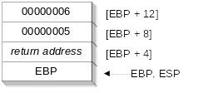
Stack Frame Example (1 of 2)
.data
sum DWORD ?
.code
push 6 ; second argument
push 5 ; first argument
call AddTwo ; EAX = sum
mov sum,eax ; save the sum
AddTwo PROC
push ebp
mov ebp,esp
.
.

Slide 31
Stack Frame Example (2 of 2)
AddTwo PROC
  push ebp
  mov ebp,esp ; base of stack frame
  mov eax,[ebp + 12] ; second argument (6)
  add eax,[ebp + 8] ; first argument (5)
  pop ebp
  ret 8 ; clean up the stack
AddTwo ENDP ; EAX contains the sum

Slide 32
Your turn . . .
Create a procedure named Difference that subtracts the first argument from the second one. Following is a sample call:
    push 14 ; first argument
    push 30 ; second argument
    call Difference ; EAX = 16
Difference PROC
  push ebp
  mov ebp,esp
  mov eax,[ebp + 8] ; second argument
  sub eax,[ebp + 12] ; first argument
  pop ebp
  ret 8
Difference ENDP

Slide 33
Passing Arguments by Reference (1 of 2)
The ArrayFill procedure fills an array with 16-bit random integers
The calling program passes the address of the array, along with a count of the number of array elements:
.data
count = 100
array WORD count DUP(?)
.code
push OFFSET array
push COUNT
call ArrayFill

Slide 34
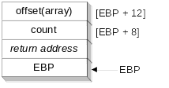
Passing Arguments by Reference (2 of 2)
ArrayFill can reference an array without knowing the array's name:
ArrayFill PROC
push ebp
mov ebp,esp
pushad
mov esi,[ebp+12]
mov ecx,[ebp+8]
.
.
ESI points to the beginning of the array, so it's easy to use a loop to access each array element. View the complete program.

Slide 35
LEA Instruction
The LEA instruction returns offsets of both direct and indirect operands.
  OFFSET operator can only return constant offsets.
LEA is required when obtaining the offset of a stack parameter or local variable. For example:
CopyString PROC,
count:DWORD
LOCAL temp[20]:BYTE
mov edi,OFFSET count ; invalid operand
mov esi,OFFSET temp ; invalid operand
lea edi,count ; ok
lea esi,temp ; ok

Slide 36
Creating Local Variables
To explicitly create local variables, subtract their total size from ESP.
The following example creates and initializes two 32-bit local variables (we'll call them locA and locB):
MySub PROC
push ebp
mov ebp,esp
sub esp,8
mov [ebp-4],123456h ; locA
mov [ebp-8],0 ; locB
.
.

Slide 37
Recursion
What is recursion?
Recursively Calculating a Sum
Calculating a Factorial

Slide 38
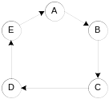
What is Recursion?
The process created when . . .
  A procedure calls itself
  Procedure A calls procedure B, which in turn calls procedure A
Using a graph in which each node is a procedure and each edge is a procedure call, recursion forms a cycle:

Slide 39
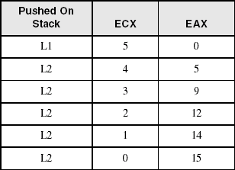
Recursively Calculating a Sum
The CalcSum procedure recursively calculates the sum of an array of integers. Receives: ECX = count. Returns: EAX = sum
CalcSum PROC
cmp ecx,0 ; check counter value
  jz L2 ; quit if zero
  add eax,ecx ; otherwise, add to sum
  dec ecx ; decrement counter
  call CalcSum ; recursive call
L2: ret
CalcSum ENDP
View the complete program
Stack frame:

Slide 40
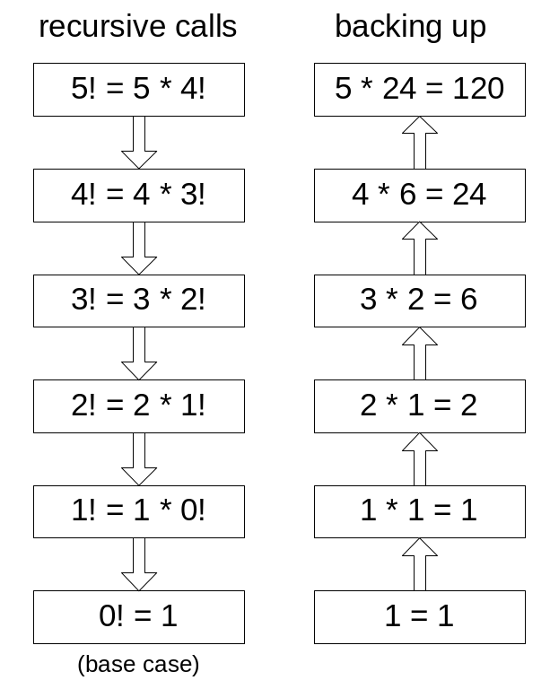
Calculating a Factorial (1 of 3)
This function calculates the factorial of integer n. A new value of n is saved in each stack frame:
int function factorial(int n)
{
if(n == 0)
return 1;
else
return n * factorial(n-1);
}
As each call instance returns, the product it returns is multiplied by the previous value of n.

Slide 41
Calculating a Factorial (2 of 3)
Factorial PROC
push ebp
mov ebp,esp
mov eax,[ebp+8] ; get n
cmp eax,0 ; n < 0?
ja L1 ; yes: continue
mov eax,1 ; no: return 1
jmp L2
L1: dec eax
push eax ; Factorial(n-1)
call Factorial
; Instructions from this point on execute when each
; recursive call returns.
ReturnFact:
mov ebx,[ebp+8] ; get n
mul ebx ; ax = ax * bx
L2: pop ebp ; return EAX
ret 4 ; clean up stack
Factorial ENDP
See the program listing

Slide 42
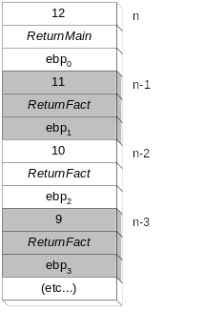
Calculating a Factorial (3 of 3)
Suppose we want to calculate 12!
This diagram shows the first few stack frames created by recursive calls to Factorial
Each recursive call uses 12 bytes of stack space.

Slide 43
Multimodule Programs
A multimodule program is a program whose source code has been divided up into separate ASM files.
Each ASM file (module) is assembled into a separate OBJ file.
All OBJ files belonging to the same program are linked using the link utility into a single EXE file.
  This process is called static linking

Slide 44
Advantages
Large programs are easier to write, maintain, and debug when divided into separate source code modules.
When changing a line of code, only its enclosing module needs to be assembled again. Linking assembled modules requires little time.
A module can be a container for logically related code and data (think object-oriented here...)
  encapsulation: procedures and variables are automatically hidden in a module unless you declare them public

Slide 45
Creating a Multimodule Program
Here are some basic steps to follow when creating a multimodule program:
  Create the main module
  Create a separate source code module for each procedure or set of related procedures
  Create an include file that contains procedure prototypes for external procedures (ones that are called between modules)
  Use the INCLUDE directive to make your procedure prototypes available to each module

Slide 46
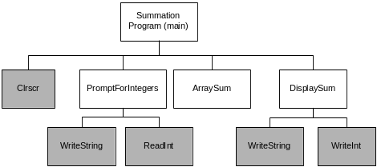
Example: ArraySum Program
Let's review the ArraySum program from Chapter 5.
Each of the four white rectangles will become a module.

Slide 47
Sample Program output
Enter a signed integer: -25
Enter a signed integer: 36
Enter a signed integer: 42
The sum of the integers is: +53

Slide 48
INCLUDE File
The sum.inc file contains prototypes for external functions that are not in the Irvine32 library:
INCLUDE Irvine32.inc
PromptForIntegers PROTO,
ptrPrompt:PTR BYTE, ; prompt string
ptrArray:PTR DWORD, ; points to the array
arraySize:DWORD ; size of the array
ArraySum PROTO,
ptrArray:PTR DWORD, ; points to the array
count:DWORD ; size of the array
DisplaySum PROTO,
ptrPrompt:PTR BYTE, ; prompt string
theSum:DWORD ; sum of the array

Slide 49
Inspect Individual Modules
Main
PromptForIntegers
ArraySum
DisplaySum
Custom batch file for assembling and linking.

Slide 50

The End

